Slide 1
Call For Nation
COVID-19 Data Visualization Toolkit
https://covid19.shoshikkha.com/
Developed By: Muntasir Wahed & Redwan Ahmed Rizvee
Category: Access to Information

Slide 2
Who We Are
Completed BSc in Computer Science and Engineering from the University of Dhaka
Currently working as Research Assistants at the Data & Design Lab, under the supervision of Dr. Moinul Islam Zaber and Dr. Amin Ahsan Ali

Slide 3
Motivation
How is COVID-19 affecting Bangladesh and other countries?
Crisis
Total Cases, Death, Recovered
A one-stop solution providing access to information and appropriate visualizations
How is Bangladesh and the other countries responding?
Response
Measures to prevent, Economic Response

Slide 4

How We Can Track?
Metrics
We can Observe
Number of Cases
Are We Flattening the Curve?
Number of Recovered Patients
Number of Deaths
Notes:
Check something

Slide 5
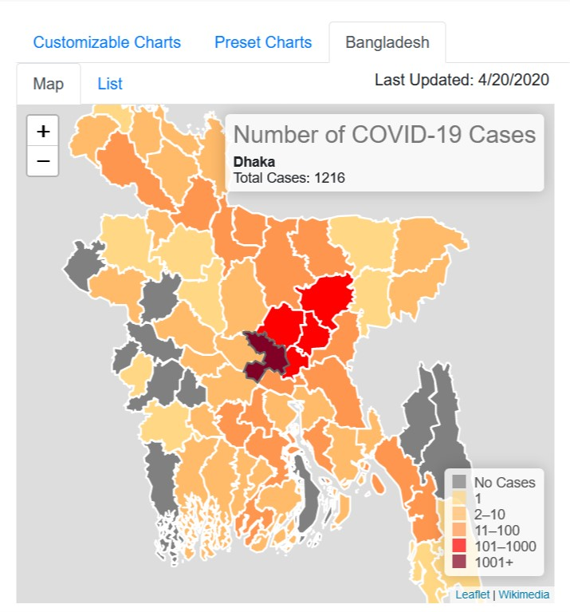
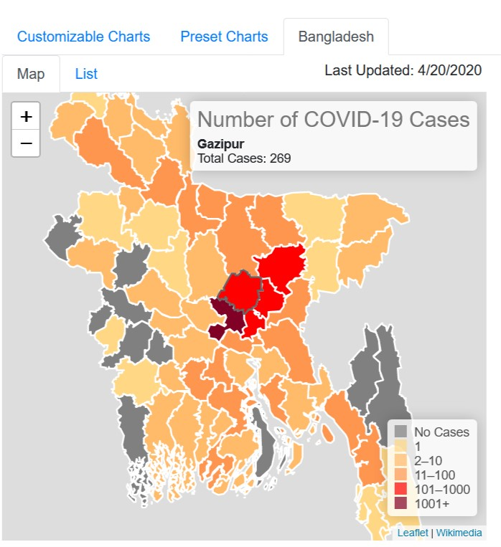
How We Can Track?
Where Coronavirus is spreading fast?
Which areas are in better and which are in worse condition?
Can be helpful to take better policies

Slide 6
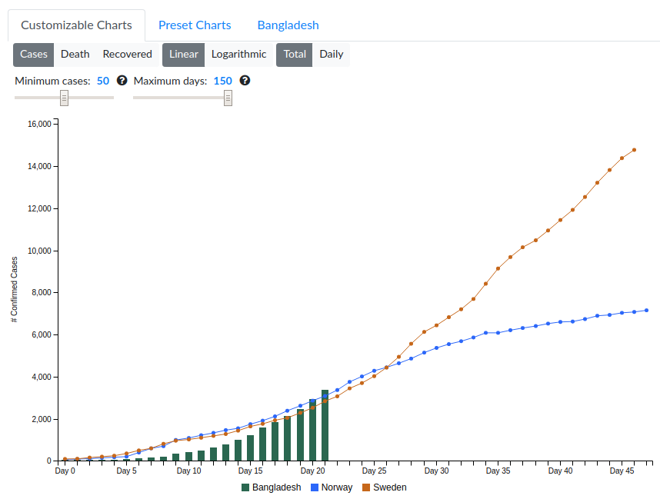
How We Can Track?
Is
Lockdown 🔒 slowing the spread of the virus?
Sweden did not impose any lock down
Day 26:The point where curves started to deviate
Norway imposed lockdown 🔒 on Day 8 (March 12, 2020))

Slide 7
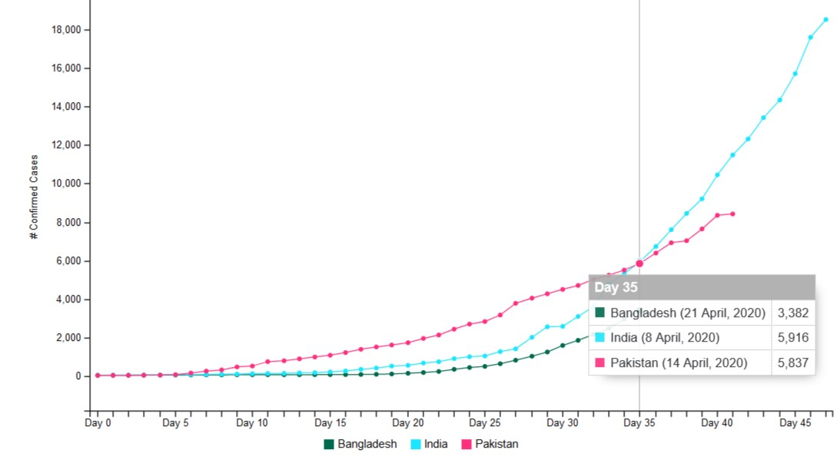
How We Can Track?
How is Bangladesh doing compared to the other countries?
Do we need to adopt some of their prevention mechanisms?

Slide 8
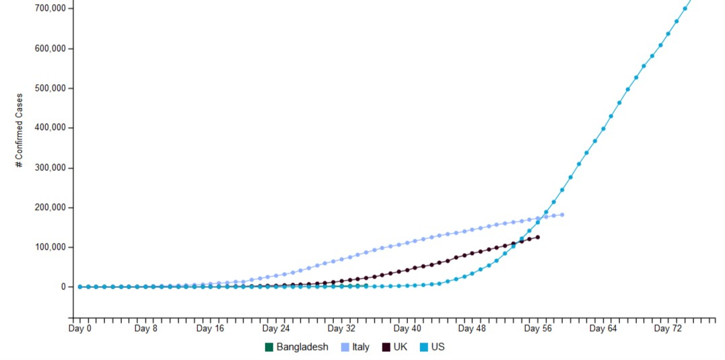
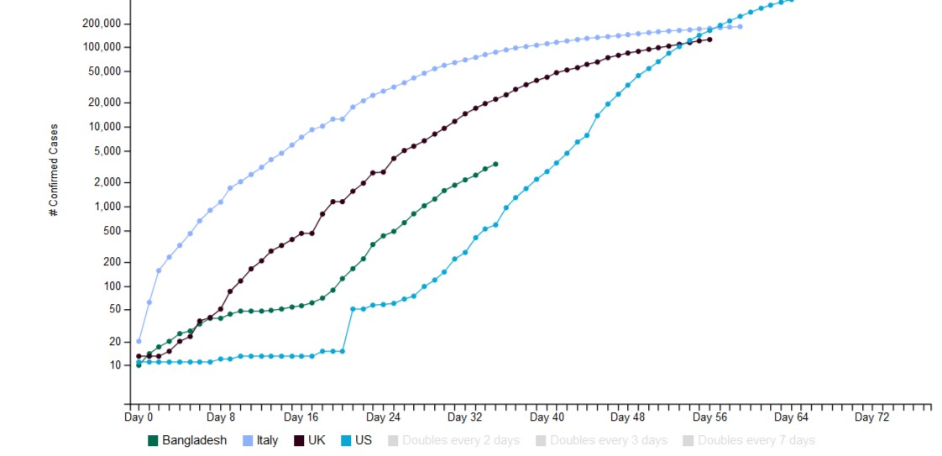
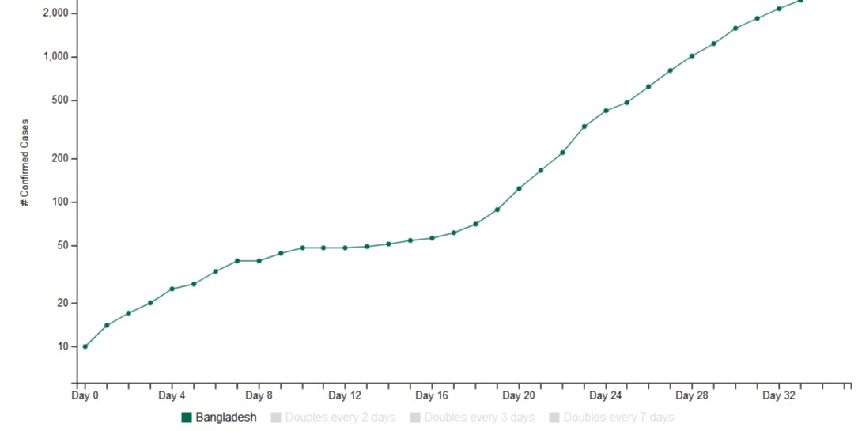
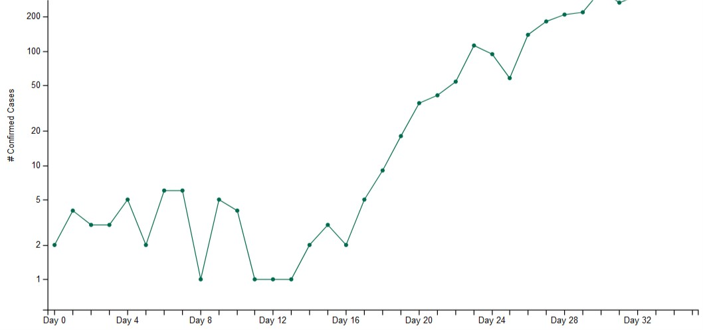
How We Can Track?
Significance of understanding different types of changes
Linear Change
Logarithmic Change
Change in total basis
Change in daily basis

Slide 9
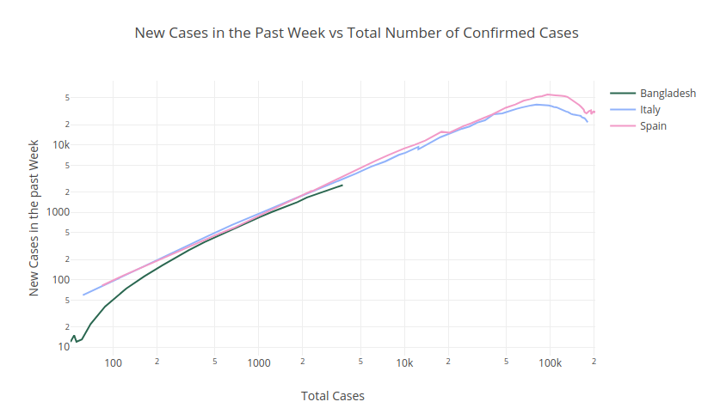
How We Can Track?
Have we reached the peak?

Slide 10
Proposed Solution
We want to provide answer to all these questions in a single platform. In summary, we will provide answer in two different modules.
Crisis: What is the spread of the pandemic at the national and the subnational level?
Response: What different measures are being taken by different countries?
We have already developed the Crisis section of the website.
In the future, we will work on the Response section, while also providing further improvement to the Crisis section.

Slide 11
Scalability and Sustainability Model
Scalability
Caching makes sure that the user experiences faster load times. It also ensures lower load on the server
Website’s fast interactivity ensured by component wise update rather than complete structure reloading.
Able to tackle huge amount of data due to efficient data structure design.
Plans for lightweight APIs to make data available with proper caching mechanism.
Sustainability
Makes sure that the website is useful for a wide range of audience - general people, researchers and policymakers. We have already gathered feedbacks from researchers and general users.
A large amount of user interactivity added to provide them freedom to customize based on their preferences
In-depth analysis of different parameters and options, as well possible comparison for a wide range of countries

Slide 12
Timeplan
Task | Time Required | Status
Minimum Viable Product | 1 Week | Completed
Designing the Response section | 1 Week | In Progress
Development of the Response section | 1 Week | To-Do
Changing the Data Sources | 2 Days | To-Do
Integrating REST APIs | 5 Days | To-Do

Slide 13
Development process of the solution
IEDCR
John Hopkins CSSE
Press Briefings
Data Collection Layer
Designed data structure and algorithm to process, format and analyze the data
Logistic layer
Lucrative user view developed using HTML5, CSS, Javascript, Bootstrap for device independent platforms.
Visualization Layer

Slide 14
Data Collection
Institute of Epidemiology, Disease Control and Research (IEDCR), Bangladesh.
https://www.iedcr.gov.bd/
2019 Novel Coronavirus COVID-19 (2019-nCoV) Data Repository by Johns Hopkins CSSE
https://github.com/CSSEGISandData/COVID-19/
Live telecasted Press Briefings of Ministry of Health and Family Welfare, Government of People’s Republic of Bangladesh and IEDCR to live update our website.
Everyday at 2.30 pm (BDT)
Main objective of our website is to provide and reach authentic information to our users.
We update our data regularly from the attached links and medias.

Slide 15
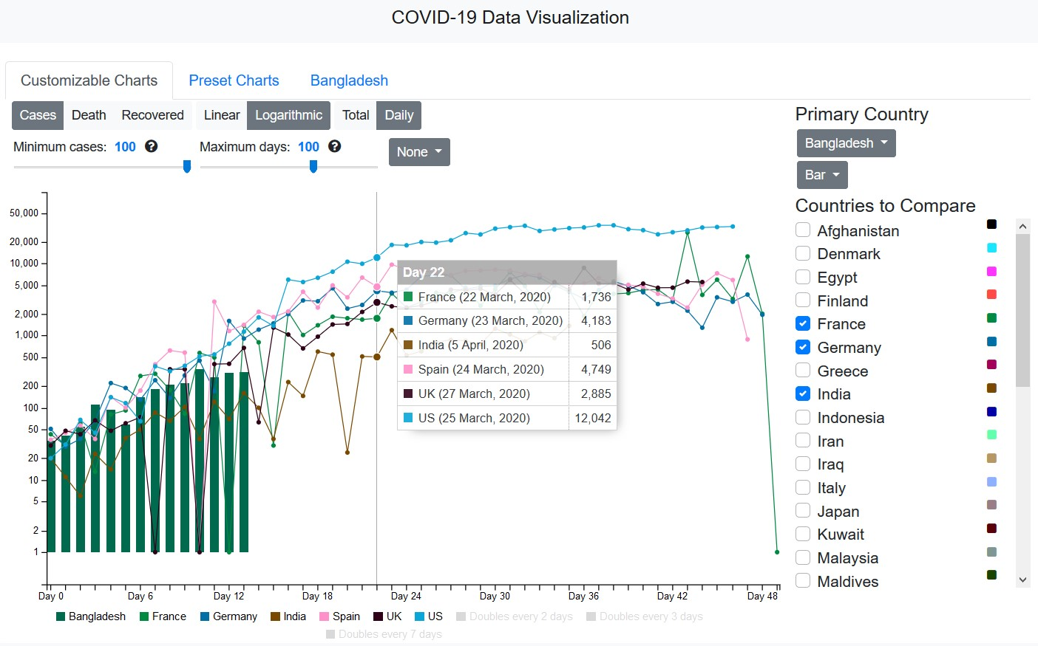
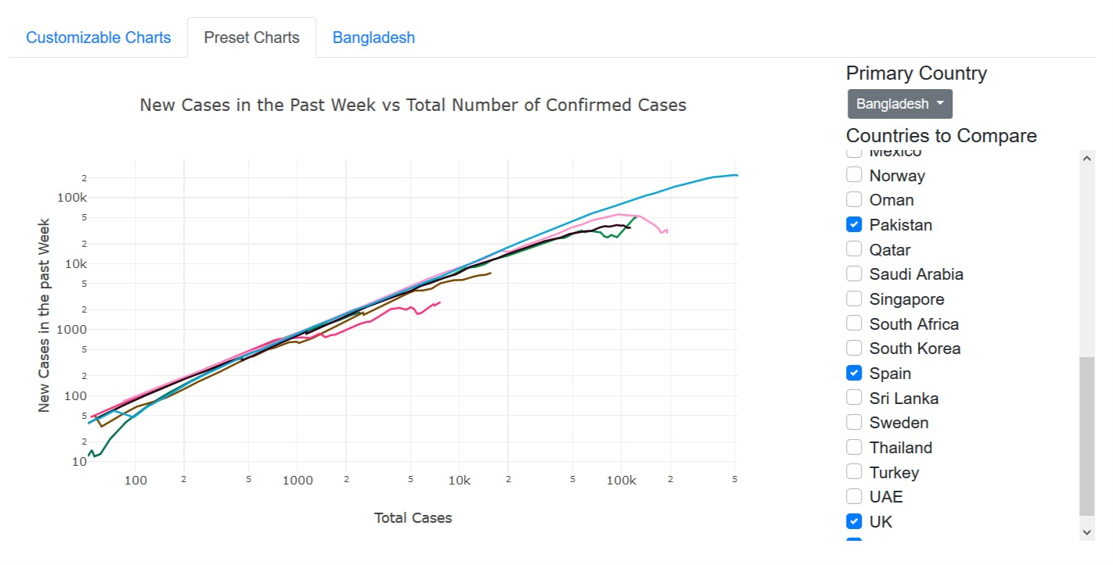
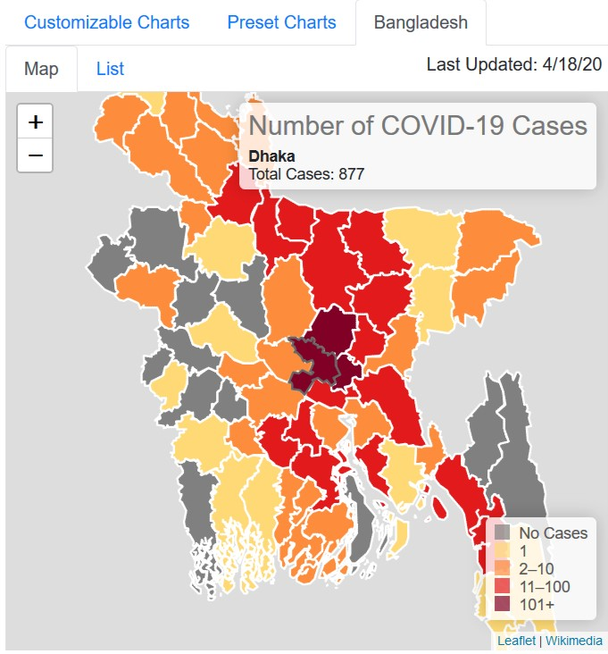
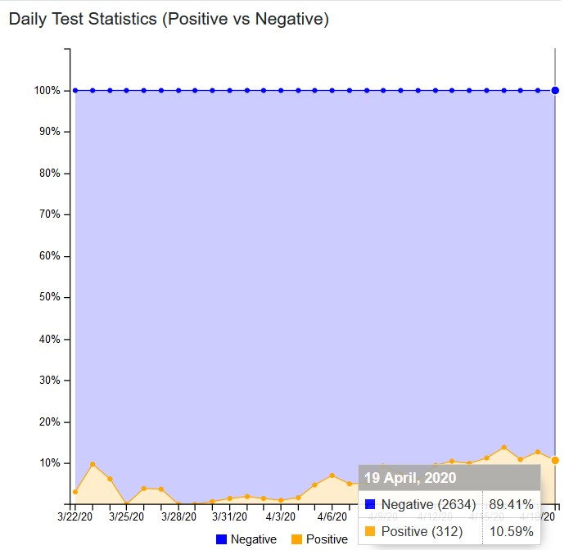
Thanks!
Contact us:
Muntasir Wahed
immuntasir@gmail.com
Redwan Ahmed Rizvee
rizveeredwan.csedu@gmail.com
https://covid19.shoshikkha.com/

Slide 16
How We Can Track?
Which metric to observe? Cases or Death?
Should I focus at daily increase or the total number?
Which scale to use? Linear or Logarithmic?
Which countries should I compare Bangladesh with?
How are the districts faring with the situation?
Which country imposed lock down and when? Is the lockdown helping them? What about the countries that removed lock down?
Notes:
Check something

